Slide 1
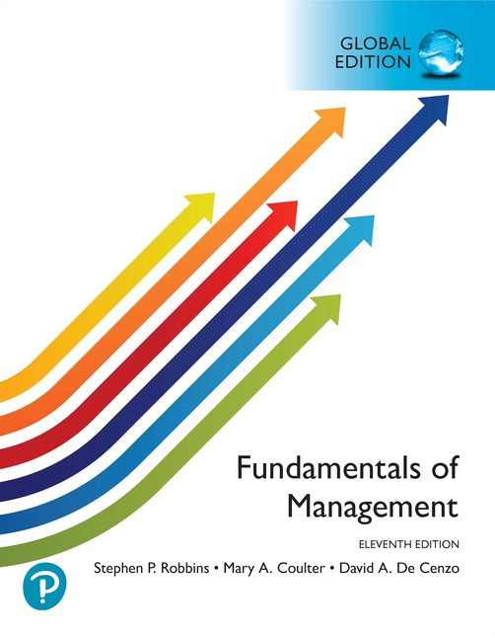
現代管理學 ch1 管理者與管理
1-<number>

Slide 2
3
Key Issues in Management

Slide 3
Learning Objectives
The impact of globalization on organizations。
How societal expectations influence managers and organizations。
factors within organizations that lead to ethical and unethical behavior。
how the workforce is changing and how these changes affect how organizations are managed。
3-<number>

Slide 4
個案介紹:樂天 Rakuten
自2008年開始，樂天佈局全球市場，挾著日本第一頭銜，目前在13國家擁有電子商務平台服務，服務國家更多達28個.
樂天集團身為大電商，它提出電子商務企業國際化的四大關鍵
  集團英語化，員工視野變寬
  海外分佈，保有總部文化
  培養在地人才，最終得放權
  共用平台貫徹全球化
  知識 是 成長學習的翅膀, 興趣不是！！！！
  “Knowledge is the wings of growth and learning—not interest!!!!”
6-<number>

Slide 5


A. How Does Globalization Affect Organizations?
What is “Globalization”?
  Trading goods and services with consumers in other countries。
  An organization can also be considered international—or part of financial globalization—if it uses financial resources and other inputs from outside its home country.
3-<number>

Slide 6
What Is Globalization and How Does It Affect Organizations?
Initially, managers begin with global sourcing—procuring raw materials or labor from around the world at the lowest cost to enhance competitiveness.
As a company progresses further in globalization, each subsequent stage beyond global sourcing requires greater investment and exposes the organization to higher levels of risk.
3-<number>

Slide 7
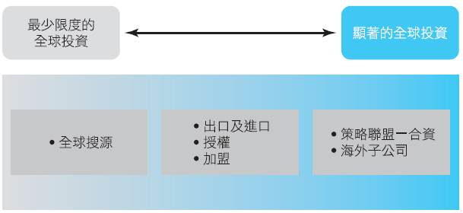
What Is Globalization and How Does It Affect Organizations?
  The next step is the exporting the organization’s products to other countries. Additionally, organizations may engage in importing—acquiring products manufactured overseas for domestic sale.
How Organizations Go Global
3-<number>

Slide 8

What Is Globalization and How Does It Affect Organizations?
    Managers may also use licensing(授權)or franchising(加盟):
      Licensing grants another organization the right to use a company’s brand name, technology, or product specifications in exchange for an upfront fee(買斷) or royalty based on sales.
  Licensing is used by firms to produce or sell another company’s products，
  Franchising is used by firms that wish to operate under another company’s brand name and business model.
3-<number>

Slide 9

A2. What Are the Different Types of Global Organizations?
Multinational corporation (多國籍企業, MNC)
  Operates in multiple countries.
Multidomestic corporation (多國企業)
  Decentralizes decision-making to local subsidiaries
  Employs local staff to manage operations in each country。
  Tailors strategies to the unique characteristics of each national market.
3-<number>

Slide 10
Types of Global Organizations (continued)
Transnational organization (跨國組織) or borderless organization (無疆界組織)：
  Blends centralized and decentralized elements
  The location of headquarters or operations becomes less relevant.。
  Maximize efficiency and effectiveness in competitive global markets。
3-<number>

Slide 11
Types of Global Organizations (continued)
Global corporation (全球企業)：
  Centralizes decision-making at headquarters in the home country。
  Focuses on control and global efficiency。
  Local subsidiaries follow directives from the home office。
1-<number>

Slide 12
Types of Global Organizations (continued)
Strategic Alliances：
  Two companies share resources and knowledge。
  A global strategic alliance involves collaboration to jointly develop new products or build production facilities。
Joint Ventures：
  Partners create a new, independent company to achieve a specific business objective。
Foreign Subsidiary:
  The organization establishes a wholly owned, independent factory or office in a foreign country—representing direct foreign investment.
1-<number>

Slide 13
A3. What Must Managers Know to Manage a Global Organization?
Parochialism (本位主義)
  It ignores foreign ways of living and working, values, and customs—and assumes “our way is always better.”
現代管理學 ch3 整合性管理議題
3-<number>

Slide 14
Three Global Attitudes
Ethnocentric attitude(本國取向態度)
  Believes the best work methods are those used in the home country (where headquarters is located).
Polycentric attitude(多國取向態度)
  Assumes that local managers in the host country know the best way to run operations there.
Geocentric attitude(全球取向態度)
  Focuses on identifying the best practices and talent worldwide, regardless of nationality.
1-<number>

Slide 15
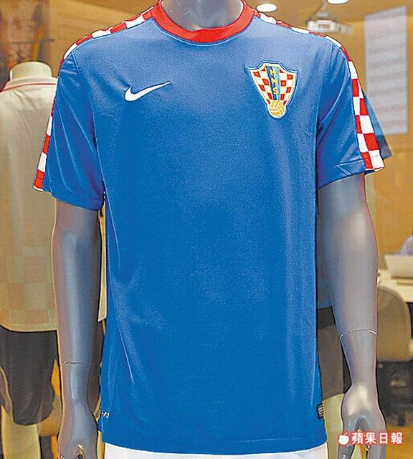
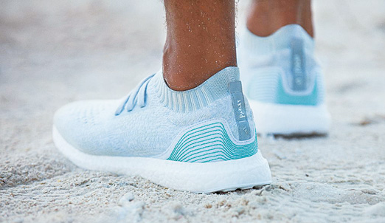
個案介紹:服裝業者承諾
愈來愈多的服裝業者承諾對環保問題投入關注，例如利用回收寶特瓶製成足球衣、回收海洋塑膠垃圾製成鞋類產品
1-<number>

Slide 16

B. What Does Society Expect from Organizations and Managers?
  Corporate Social Responsibility (企業社會責任)
  The commitment to contribute to economic development while improving the quality of life for employees, their families, local communities, and society at large.
  CSR is distinct from two related concepts:
    social obligations (社會義務)
      Activities undertaken to fulfill economic and legal responsibilities.
    social responsiveness (社會回應)
      The capacity to respond to emerging societal needs through proactive social actions.
3-<number>

Slide 17
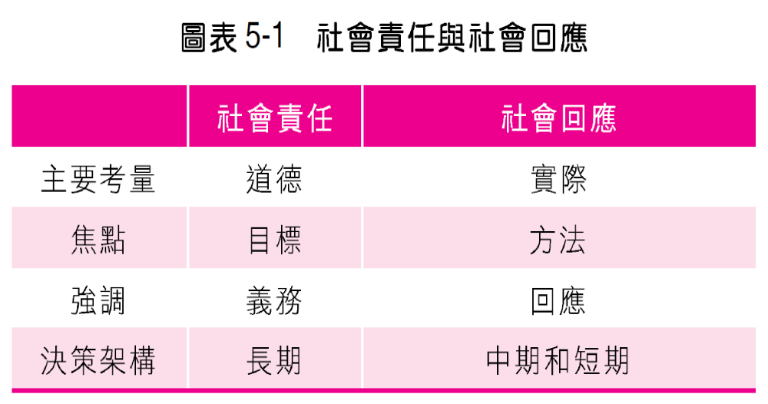
Social Responsibility
  An willingness to engage in actions that benefit society.
1-<number>

Slide 18
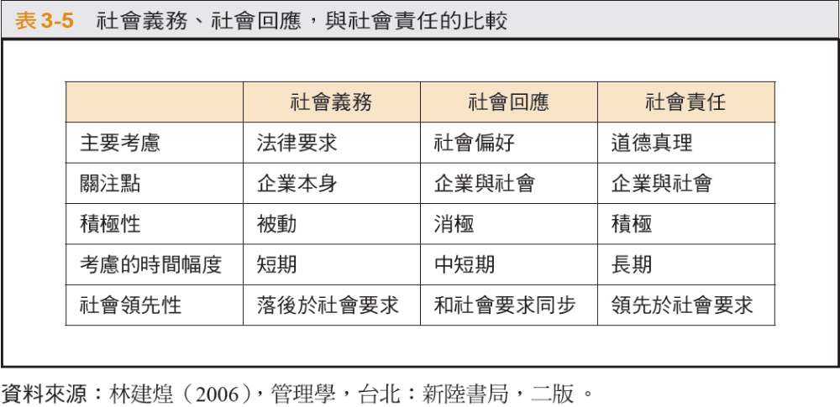
1-<number>

Slide 19
Practical Ethical Behavior
Toward the environment
Toward employees:
  Laws regarding employee rights, benefits, and welfare.
Toward customers:
  Provide safe products, accurate information, after-sales service, necessary guidance, and respect consumer choice.
Toward competitors:
  Cooperating the appropriate while maintaining fair competition.
Toward investors:
  Report financial performance accurately and transparently.
Toward the community:
  Create jobs and generate wealth locally.
1-<number>

Slide 20
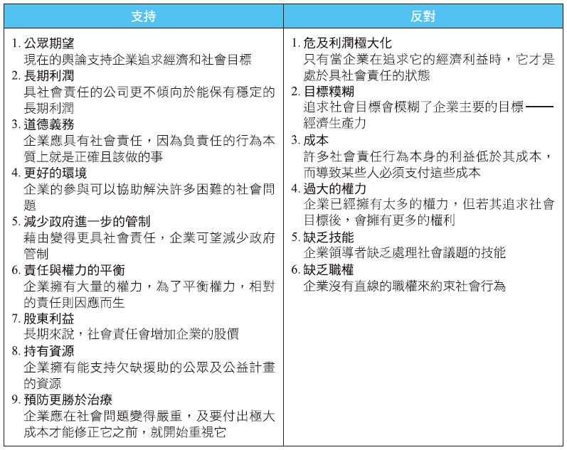
B1. Should Organizations Be Socially Responsible?
Arguments For and Against Corporate Social Responsibility
3-<number>

Slide 21
Should Organizations Be Socially Responsible?
Milton Friedman’s View
  Managers’ primary duty is to maximize returns for shareholders.
  When managers allocate resources to “social causes,” they increase company costs—ultimately passed on to consumers through higher prices or reflected in reduced shareholder dividends.
Socioeconomic View
  Profit-making should include protecting and enhancing societal welfare. Companies are accountable not only to shareholders but also to society at large.
Social Responsiveness
  Managers often align decisions with prevailing social norms and values, responding to market-driven societal expectations
1-<number>

Slide 22
Does Social Responsibility Affect Financial Performance?
  Most studies find a slight positive relationship. They conclude that managers can—and should—act responsibly without harming performance.
Conclusion: Corporate social involvement does not necessarily reduce economic performance.
1-<number>

Slide 23
2. Sustainability
  The ability to integrate economic, environmental, and social opportunities into its strategy to achieve business goals and enhance long-term shareholder value. 。
  This requires deep engagement and communication with stakeholders (利害關係人) to make informed, strategic decisions.
3-<number>

Slide 24
How Organizations Pursue Environmental Sustainability?
Legal (or light green)
  Meets minimum legal requirements—reflects social obligation.
Market approach
  Responds to customer preferences for eco-friendly products.
Stakeholder approach
  Environmental expectations of all stakeholders.
Activist (or deep green) approach
  Actively protects Earth’s resources and the highest level of environmental sensitivity.
1-<number>

Slide 25
3. Ethical and Unethical Behavior
Ethics（ 道德?倫理）
  Ethics refers to principles, values, and beliefs that define right and wrong conduct.
  Utilitarian view(功利觀點): Ethical decisions aim to produce the greatest good for the greatest number.。
  Rights-based view(倫理的權利) Emphasizes respecting and protecting individual freedoms and fundamental rights。
3-<number>

Slide 26
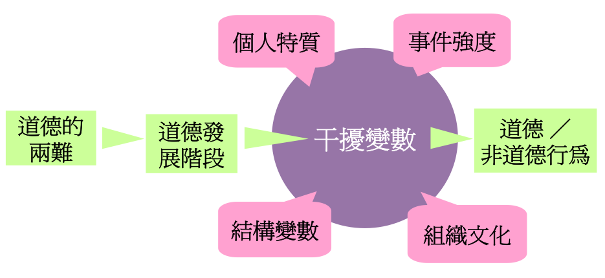
Factors Influencing Ethical and Unethical Behavior
1-<number>

Slide 27
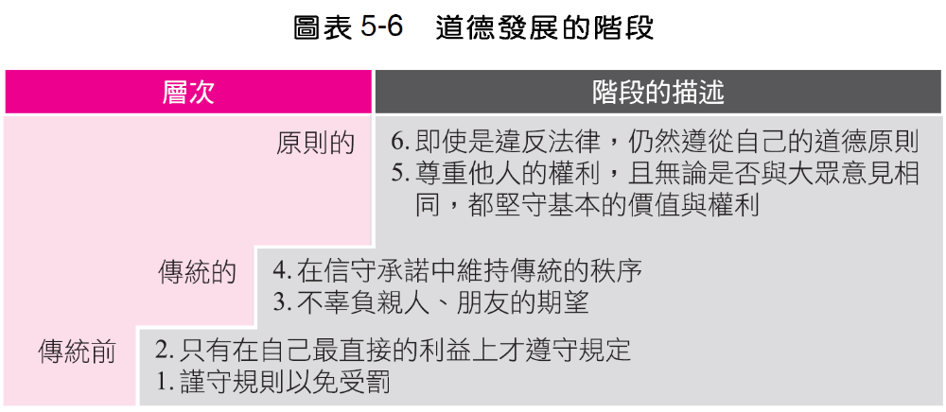
Stages of Ethical Development
1-<number>

Slide 28
1. Individual Characteristics
Values: Core beliefs about right and wrong
Personality variables: Ego strength (自我意識強度) : The strength of one’s convictions。
  Locus of control(內外控) : The degree to which a person believes they control their own fate
    Internals: Believe they control their destiny.
    Externals: Believe fate is determined by luck or chance.
1-<number>

Slide 29
2. Structural Variables
Organizational design influences ethical behavior:
  Organizational goals; Performance appraisal systems; Reward and punishment mechanism
1-<number>

Slide 30
3. Organizational Culture
Cultures that encourage risk-taking, strong controls, and tolerance for conflict tend to promote higher ethical standards.
A strong organizational culture exerts significant influence on employee behavior—especially when it explicitly supports high moral standards.
1-<number>

Slide 31
4. Issue Intensity
Six characteristics determine how morally significant an issue is to an individual:
  傷害的程度
  對好壞的共識
  造成傷害的機率
  影響的立即性
  受害者的親近性
  影響的集中性
  1. Magnitude of consequences (potential harm) 2. Social consensus (agreement on right vs. wrong) 3. Probability of effect (likelihood harm will occur) 4. Temporal immediacy (how soon consequences occur) 5. Proximity to victims (emotional or physical closeness) 6. Concentration of effect (how concentrated or dispersed the impact is)
1-<number>

Slide 32
How Can Managers Encourage Ethical Behavior?
Employee selection
  Use hiring processes to assess candidates’ moral development, values, ego strength, and locus of control.
Codes of ethics and decision-making guidelines
  A formal code of ethics refers as the organization’s core values and expected standards of employee conduct.
1-<number>

Slide 33
D. What Does Today’s Workforce Look Like, and How Does It Affect How Organizations Are Managed?
Workforce diversity (職場多元化)
  The variety of similarities and differences among people in an organization.
Dimensions of Workplace Diversity Include:
  Age, gender, race and ethnicity, disability/abilities, religion
3-<number>

Slide 34
What Does Today’s Workforce Look Like, and How Does It Affect Management?
How Are Organizations and Managers Adapting to a Changing Workforce?
  Work-life balance programs (工作／生活平衡方案)。
    In the 1960s–70s, the “typical” employee worked Monday through Friday, 8–9 consecutive hours per day, with clearly defined workplace and schedule.
    Today? Work arrangements are far more flexible and varied.
3-<number>

Slide 35
What Does Today’s Workforce Look Like, and How Does It Affect Management?
  Contingent jobs (暫時性工作)。
    Shift from traditional full-time roles to a contingent workforce(約聘人員)—including part-time, temporary, and contract workers hired as needed. 。
    Contingent workers often lack the stability, benefits, and sense of organizational identity that permanent employees enjoy, which may reduce their commitment and motivation.
  Generational differences (世代差異)。
    Differences in values, technology use, and expectations across generations (e.g., Baby Boomers, Gen X, Millennials, Gen Z,..) can lead to misunderstandings and conflict in management practices.
3-<number>

